Slide 2
Infrastructure and Jobs Investment Act (IIJA) Broadband Planning Programs
West Virginia Association of Regional Councils Conference
West Virginia Office of Broadband
September 7, 2022

Slide 3
WEST VIRGINIA BROADBAND
INVESTMENT PLAN
Includes Four Distinct Programs
Leverages Private Investment
Involves Local Governments
Encourages Public-Private Partnerships
CONNECTS THE UNCONNECTED

Slide 4
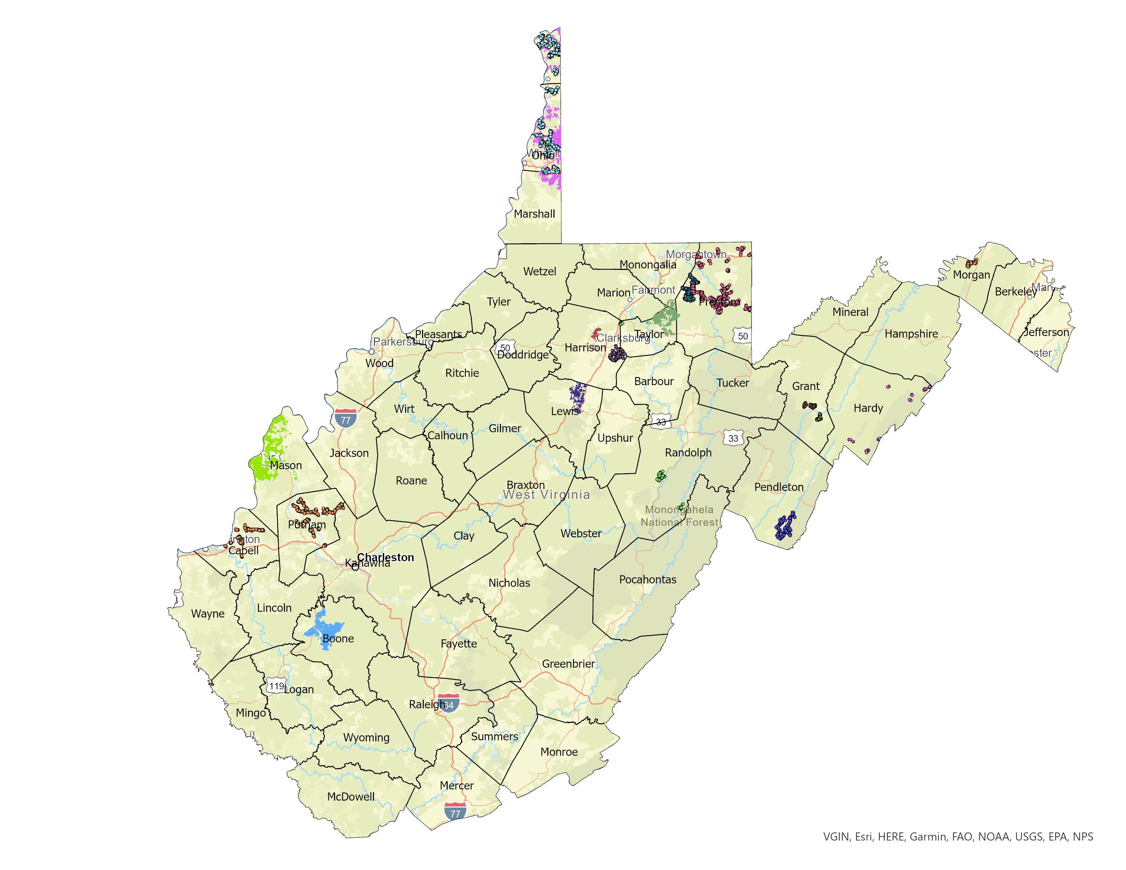
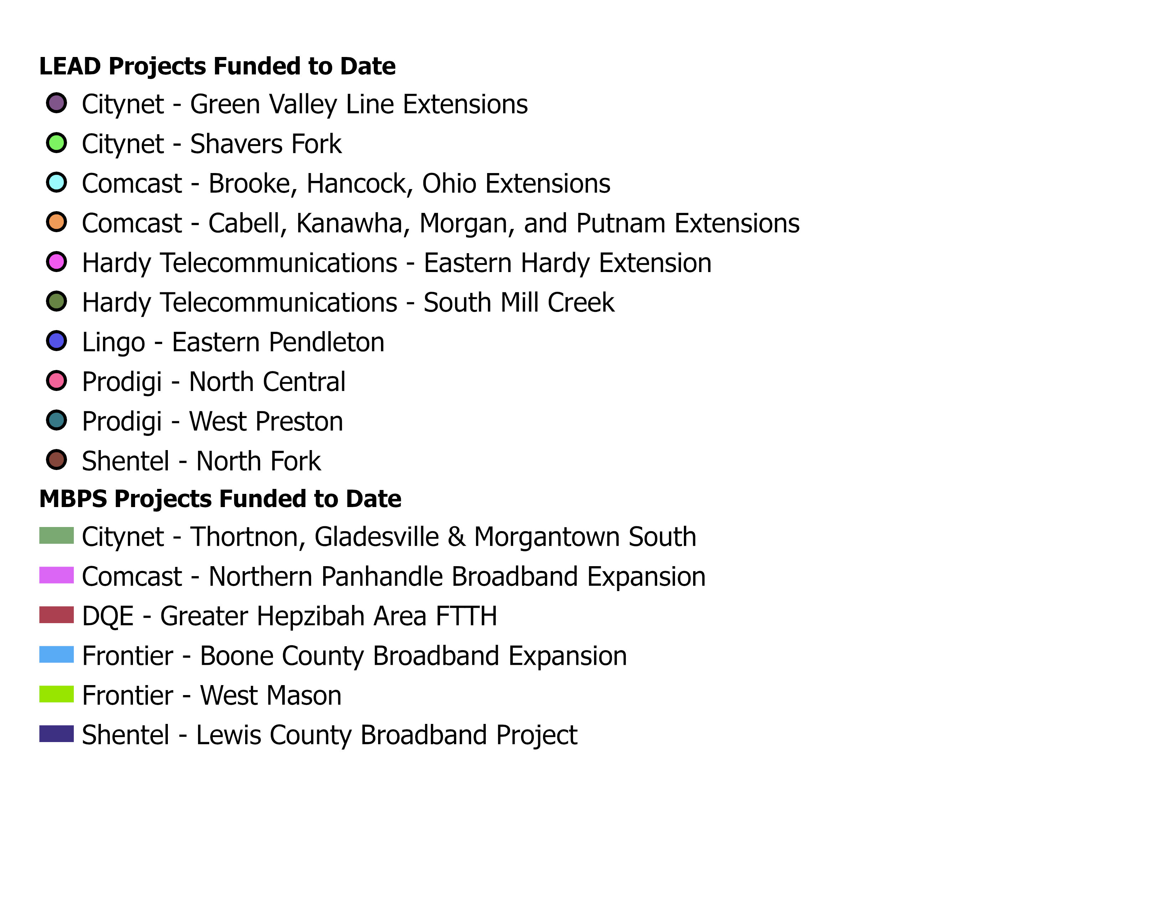
WVBIP Funded to Date $ 90 Million ARPA SLFRF $136 Million ARPA CPF

Slide 5
Infrastructure Investment and Jobs Act (IIJA)
$65 Billion: Largest Broadband Investment in U.S. History
U.S. Department of Commerce
National Telecommunications and Information Administration (NTIA)
$42.5 Billion: State Broadband Equity, Access, and Deployment (BEAD)
$2.75 Billion: Digital Equity Act Programs (DE)
$60 Million: State Planning Program
$1.44 Billion: State Capacity Program
$1.25 Billion: Competitive Grant Program
$1 Billion: Middle Mile Broadband Infrastructure Programs
Federal Communications Commission (FCC)
$14 Billion: Affordable Connectivity Fund (ACP)

Slide 6
Infrastructure Investment and Jobs Act (IIJA)
State Planning Requirements
$42.5 Billion: State Broadband Equity, Access, and Deployment (BEAD)
Eligible Entities that receive Initial Planning Funds must submit a BEAD Five-Year Action Plans to NTIA no later than 270 days after receipt of planning funds.( May 2023)
Initial Proposals due 180 days after new FCC DATA broadband maps and funding amounts issues, based upon formula. (Late 2024)
Final Proposals must be submitted to NTIA no later than 365 days after the approval of the Initial Proposal. (Late 2025)
Final Funding: Four-Year Implementation. (2024 - 2026+)

Slide 7
Infrastructure Investment and Jobs Act (IIJA)
State DE Planning Requirements
$2.75 Billion: Digital Equity Act Programs (DE)
$60 Million: State Planning Program
$1.44 Billion: State Capacity Program
$1.25 Billion: Competitive Grant Program
Eligible Entities that receive DE Planning Funds must submit DE Plans to NTIA no later than 12 months after receipt of funds.
States that fail to complete a DE Plan cannot compete for DE Implementation funds.

Slide 8
Key Planning Partners
WV Office of Broadband
WV Broadband Enhancement Council
Tilson Technology Management, Inc.
WV Regional Planning and Development Councils
WV Economic Development Council
West Virginia University, StartUp WV
Marshall University, CBER
Regional Optical Communications (ROC)
The Thrasher Group

Slide 9
Steering Committee
WV Broadband Enhancement Council
WV Library Commission
Generation WV
AARP WV

Slide 10
The Digital Equity Act

Slide 11
THE $2.75 BILLION DIGITAL EQUITY ACT
Planning and implementation programs that provide funding to promote digital inclusion and advance equity.
To ensure that all communities can access and use affordable, reliable high-speed internet.

Slide 12
THE $2.75 BILLION DIGITAL EQUITY ACT
THREE FEDERAL GRANT PROGRAMS THROUGH 2026
TWO STATE FORMULA PROGRAMS
$60 Million State Planning Program ($728,000 for WV)
$1.44 Billion Formula State Capacity Program
ONE COMPETITIVE PROGRAM
$1.25 Billion Other Eligible Entities and Projects

Slide 13
ELIGIBLE ACTIVITIES
Planning for the deployment of high-speed Internet, including conducting research, collecting data, outreach, and training
Deploying or upgrading Internet in unserved or underserved areas or improving service to community anchor organizations
Installing Internet and WiFi in multi-unit residential buildings
Adoption and Digital Equity programs
Workforce development programs and vocational training.

Slide 14
TARGETED POPULATIONS
Individuals in covered households (150 percent of the federal poverty level)
Individuals over age 60
Incarcerated individuals, not in a Federal correctional facility
Veterans
Individuals with disabilities
Individuals with a language barrier, including individuals who
Are English learners; and
Have low levels of literacy
Individuals who are members of a racial or ethnic minority group
Individuals who primarily reside in a rural area.

Slide 15
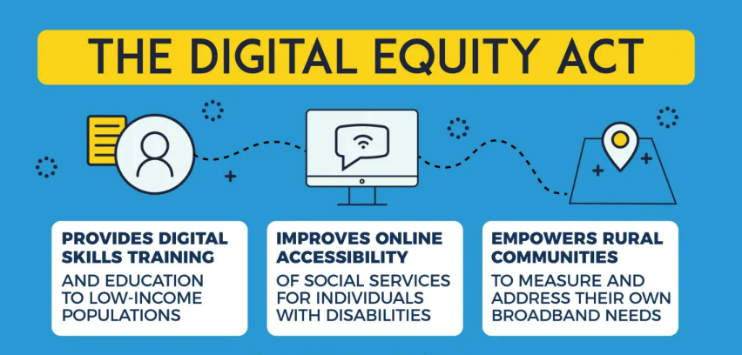

Slide 16
All State DE Plans Must Include
Statewide vision for digital equity
A digital equity framework and scorecard
Plans for digital literacy innovation programs
Proposed technology-related apprenticeship or other workforce opportunities
Integration with the State’s Economic Development Strategy, educational and health outcomes, and civic and social engagement
Action steps to implement the Digital Equity Plan that contains all requirements set forth in the NOFO.

Slide 17
West Virginia’s DE Planning Elements
1. Creation of a Digital Equity Pilot Program
2. Communications, community outreach and stakeholder engagement
3. Data collection, analysis, and visualization
4. “Holistic integration” with the BEAD Five-Year Action Plan.
Notes:
Pilot Program funds eligible entities to support community outreach and engagement, data collection, and Plan development. $245,000 total in subgrants. Entities include: RDPC offices, Libraries and others.

Slide 18
Tentative Community Outreach Locations
Raleigh County, Beckley
Cabell County, Huntington
Kanawha County, Charleston
Greenbrier County, Lewisburg
Wood County, Parkersburg
Marion County, Whitehall
Upshur County, Buckhannon
Hardy County, Moorefield
Berkeley County, Martinsburg
Ohio County, Wheeling
Hancock County, New Cumberland

Slide 19
Broadband Equity, Access and Deployment
BEAD

Slide 20
What is the BEAD Program?
A $42 Billion federal program to
ensure that all Americans have Internet access.
Funding partnerships between states or territories, communities, and stakeholders to build infrastructure and increase adoption of high-speed internet.
BEAD prioritizes unserved locations that have no Internet access or that have service under 25:3 Mbps.
WHAT DOES BEAD FUND?
Planning for Internet Deployment
Deploying or Upgrading Internet
Installing Internet in Multi-Tenant Buildings
Implementing Adoption and Digital Equity Programs
Workforce and Job Training

Slide 21
THE $42 BILLION BEAD PROGRAM
PLAN TO REACH UNIVERSAL COVERAGE THROUGH 2026
BEAD PLANNING GRANT
Completion of BEAD Five-Year Action Plan
All State Planning Grants: $5 Million
BEAD FORMULA IMPLEMENTATION GRANT
Allocation Based Upon FCC DATA ACT MAP and STATE CHALLENGE PROCESS
Funds Available Upon Approval of State Final Proposal

Slide 22
WV BEAD Planning Elements
6 KEY GOALS
Increasing the Capacity of WV Broadband
Identifying Unserved, Underserved, and Underrepresented Communities
Conducting Community Outreach and Stakeholder Engagement
Meeting Local Coordination Requirements
Providing Technical Assistance to Communities
Developing Strategies for Universal Broadband Coverage in West Virginia

Slide 23
HIGHLY SKILLED WORKFORCE PLAN
FAIR LABOR PRACTICES
HIGHLY SKILLED WORKFORCE
Eligible Entities are required to give preferential weight to projects based on the strength of the showing in their application on fair labor practices. Initial and Final Proposals must have descriptions of how subgrantees will:
• Demonstrate their compliance with federal labor and employment laws
• Ensure compliance in their own labor and employment practices, as well as those of their contractors and subcontractors.
Initial and Final Proposals must include descriptions of how the Eligible Entities will:
• Ensure subgrantees use a highly trained workforce able to carry out work safely and effectively
• Develop and promote sector-based partnerships
• Create equitable on-ramps into broadband-related jobs
• Ensure that the new jobs are available to a diverse pool of workers

Slide 24
BEAD & Digital Equity Plan Alignment
Ensuring continuity between the Core Planning Team for both plans
Creating overlap between State DE and BEAD Core Planning Teams and Partners
Establishing formal and direct communication and collaboration pathways between DE and BEAD planning teams

Slide 25
PERIOD OF PERFORMANCE for DE & BEAD
Digital Equity
BEAD Planning

Slide 26
Next Steps for WV Broadband and RPDCs
LOCAL OUTREACH AND COLLABORATION
Communication with Covered Populations and Groups that Represent Them as Required by NTIA
Sample Outreach Questions:
Do you have access to high-speed internet?
Do you have access to internet enabled devices?
Do you feel comfortable using the internet for a variety of purposes?
What would you change about your internet service plan if you could?
Focus on Solutions
Partnering with Local Organizations
Creating Asset Inventory by County to Correspond with Covered Populations
Utilizing Existing Resources: Libraries,Literacy Organizations, Institutions and Agencies
Promoting the ACP - Affordable Connectivity Program: https://www.fcc.gov/acp

Slide 27
Next Steps
PROPOSED FUNDING
Digital Equity: $20,000 per RPDC
BEAD: $25,000 per RPDC
BEAD: Capacity Building Grants for Local Partners, such as:
Regional Optical Communications (ROC) and WV Libraries
7 grants, $125,000 each
Applications for DE and BEAD Funding Available: Early October
BEAD Capacity Building Grant Applications: Fall 2022

Slide 28
2022 Look Ahead
GigReady Technical Assistance and Implementation
Additional Project Announcements
IIJA Digital Equity Planning
IIJA BEAD Five-Year Plan Development
Mapping and Data Enhancements-Broadband DATA Act
www.broadband.wv.gov

Slide 30
QUESTIONS

